Slide 1
QA Workflow
Alexandru mihai cercel – UPC - personal research

Slide 2

What is QA Workflow?
Structured pattern on how to get the work done
Use of workflow diagrams
Secure vs Agile Workflow
Stabilization phases

Slide 3
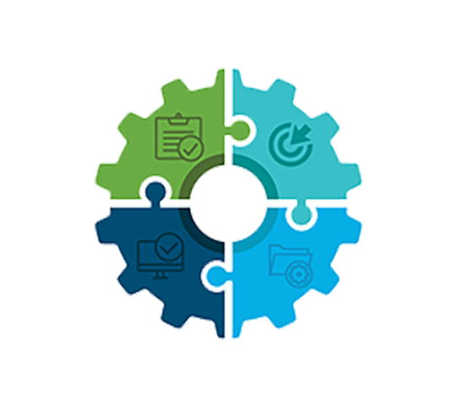
Typical workflow of a major company

Slide 4
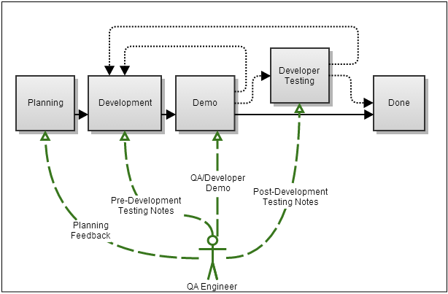
Typical workflow of a major company

Slide 5
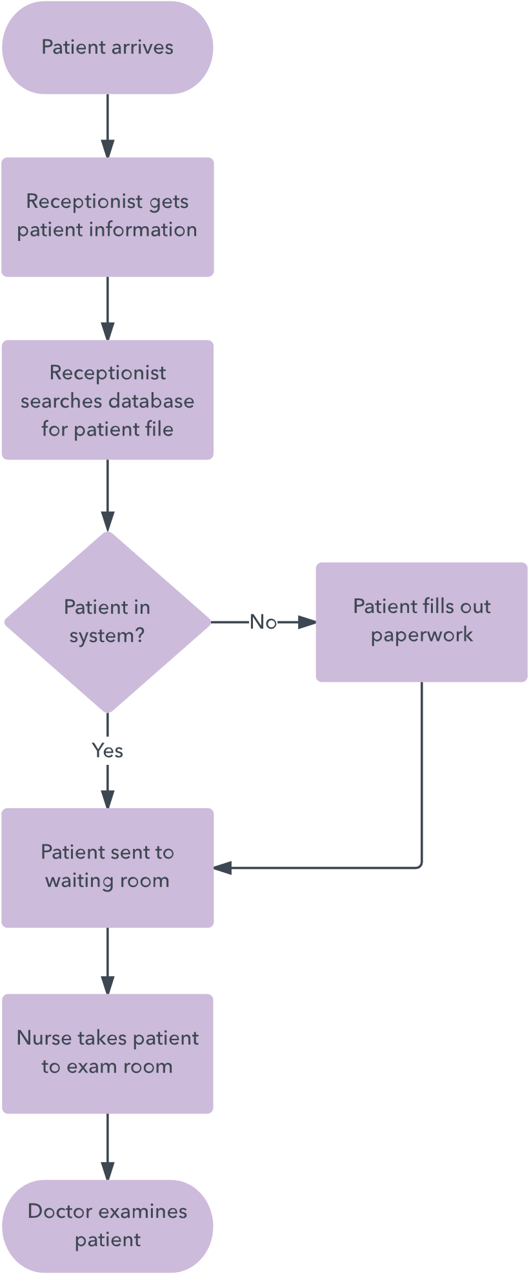
Workflow diagrams
What is It?
- Graphic overview of the workflow
- Standardized symbols and shapes
- Step by step from start to finish
When to use?

Slide 6

Workflow diagrams
Components of a workflow diagrams:
Input → Equipment or information that’s required to complete the step
Transformation → Development process
Output → Build

Slide 7
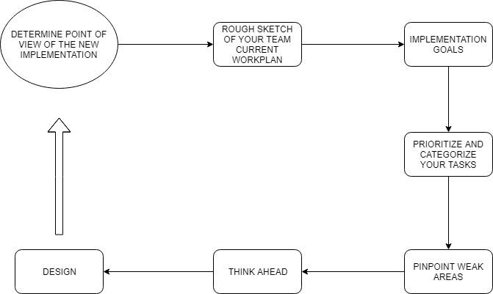
Steps to create a diagram

Slide 8

Create a rough QA workflow diagram for a Vertical Slice with draw.io
Todo 1

Slide 9
Traditional Workflow vs Agile Workflow
Traditional | Agile
Everything is established from the start | Refactoring
Predictable | Adaptable
Detailed Plan | Improvement of basic functionalities
Individual focusing | Collective focusing
Problems in prioritizing objectives | ASAP Bug tracking
No flexibility | Flexible
Uncontrolled uncertainty | High uncertainty

Slide 10
Traditional Workflow vs Agile Workflow
Balance is key!
Establish bases from the start but be prepared to make changes
Feedback from the costumer!
Don’t resist to changes, they’re good (normally).
Define a framework of action that is adaptive, depending on the environment, the team, or the context

Slide 11
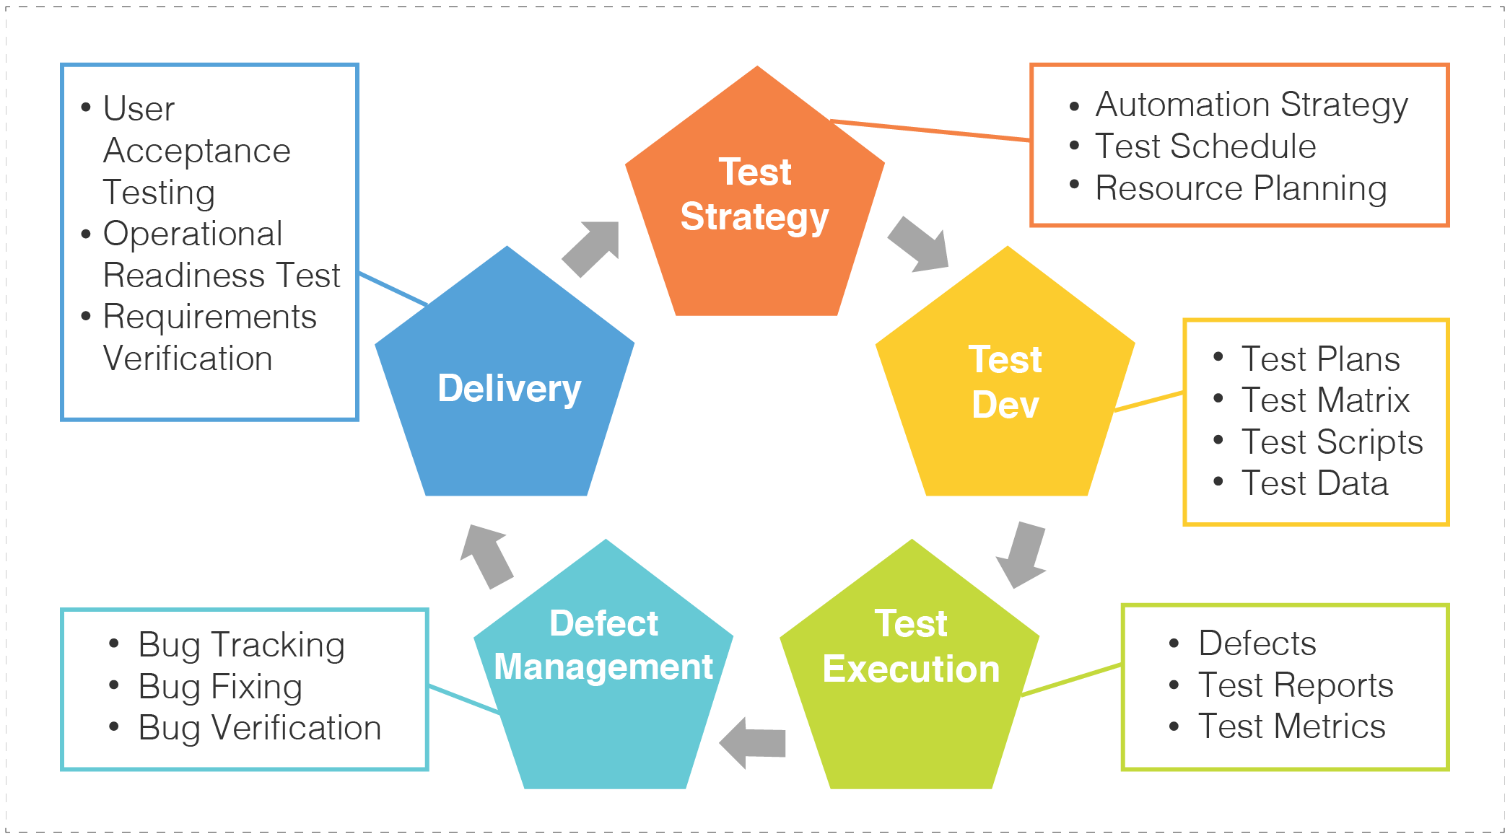

Slide 12
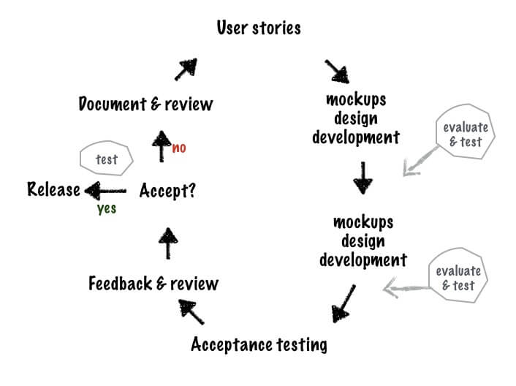
Traditional Workflow vs Agile Workflow

Slide 13
Smoke testing
Testing that determines whether the deployed build is stable or not
Ensure the stability of the application
Done when a new implementation is integrated
Done with diagrams!

Slide 14
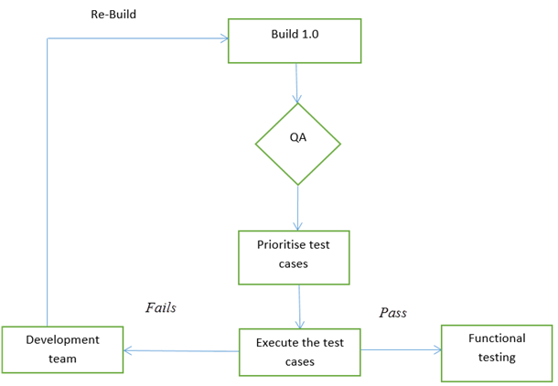
Smoke testing

Slide 15
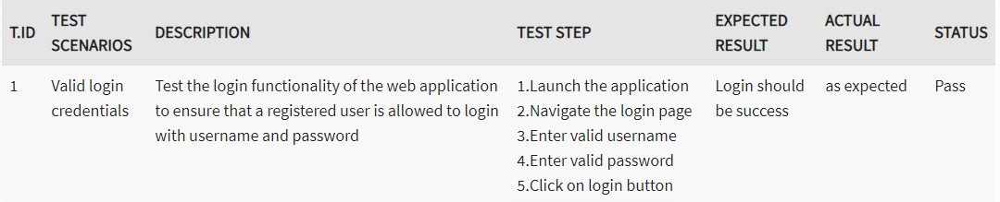
Smoke test

Slide 16
Use again draw.io to create a smoke test diagram
TODO 2

Slide 17
Stabilization phases
All implementations are stopped
Done at the end of a release
STRESS the system as much as you can
Everyone is focusing on bug fixing
Debt work is also done
Don’t let them be your cancer
More execution time doesn't mean more quality
Normally, longer stabilization phases means that the code is uncertain

Slide 18
Tips to improve QA Workflow
Stay close to your team
Break free from the classical roles and responsibilities of QA
Categorize tasks based on Importance and Complexity
Prioritize bug fixes based on usage
Give full visibility into your work
QA IS NOT PLAYING THE GAME

Slide 19
Contact
CITM – alexandruc
WhatsApp
Mail: misternyancat99@gmail.com

Slide 20
Thanks for your attention.
Feel free to ask

